Slide 1
IMAGE CAPTURING USING BLINK DETECTION
AUNSH CHAUDHARI 60004120009
KENA KOTHARI 60004120052
KEVAL LAKHANI 60004120056
GUIDED BY PROF. HARISH NARULA

Slide 2
INTRODUCTION
DOMAIN NAME – EMBEDDED SYSTEMS
USES BLINK DETECTION MECHANISM
ENABLES HANDSFREE IMAGE CAPTURE
TRANSFERS THE CAPTURED IMAGE TO A SMARTPHONE

Slide 3
Problem statement
FEASIBLE HANDSFREE IMAGE CAPTURING USING EYE BLINK DETECTION

Slide 4
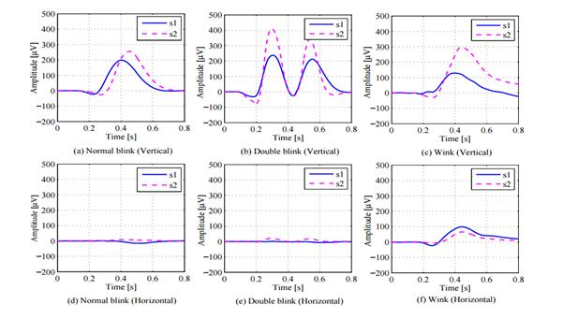
BLINK DETECTION TECHNIQUES
The 3 blink detection techniques are:
Electrooculogram –
Uses brain waves to detect blinks and differentiates between voluntary and involuntary blinks.
Analyses only one brain wave to detect an eye blink for triggering event.
It is complex and inaccurate.

Slide 5
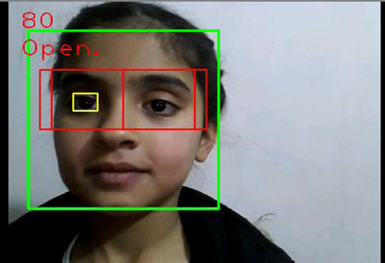
Image Processing –
This technique has the following major steps:
1. Frame Capturing
2. Face Detection
3. Eye Detection
4. Eye Tracking
5. Eye Blink Detection
It divides the captured images to a number of frames.
Not feasible because it needs another camera to capture the movement of the eye.

Slide 6
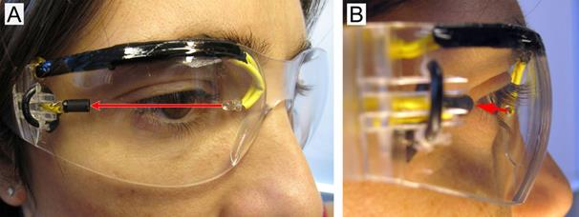
Infrared technology –
Uses Infrared emitter and detector to detect an eye blink.
Easily differentiates between voluntary and involuntary blinks.
All the processing is done by the micro-controller.
Components are easily available in market.
The device is cost friendly and user friendly.
Infrared ray wavelengths are adjusted so that they do not harm human eye.

Slide 7
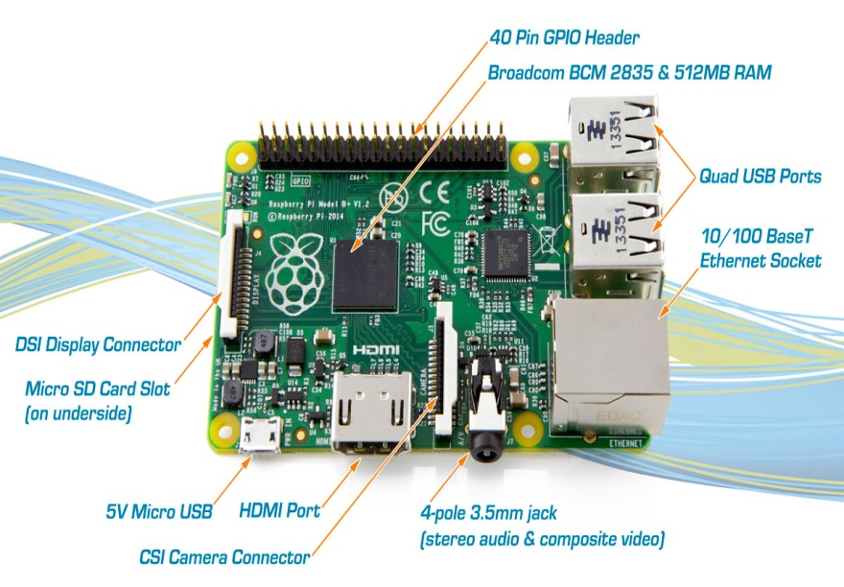
MICRO CONTROLLER
The micro-controller used in the project is a RASPBERRY PI module
The Raspberry Pi is a series of credit card–sized single-board computers
The model chosen is a RAS PI B+ module
Advantages of RAS PI B+ :
* Lower Power Consumption
* More USB
* Micro SD
* More GPIO

Slide 8
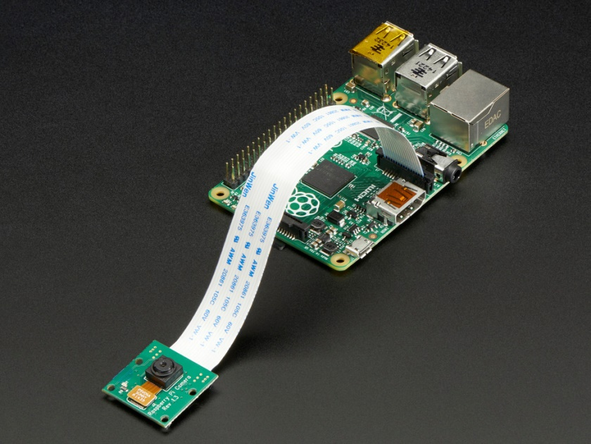
Camera Module
The camera well suited for this project is Raspberry pi camera board.
The resolution of the image captured is 5MP.
It is connected to BCM 2835 processor on Pi via the CSI bus.

Slide 9
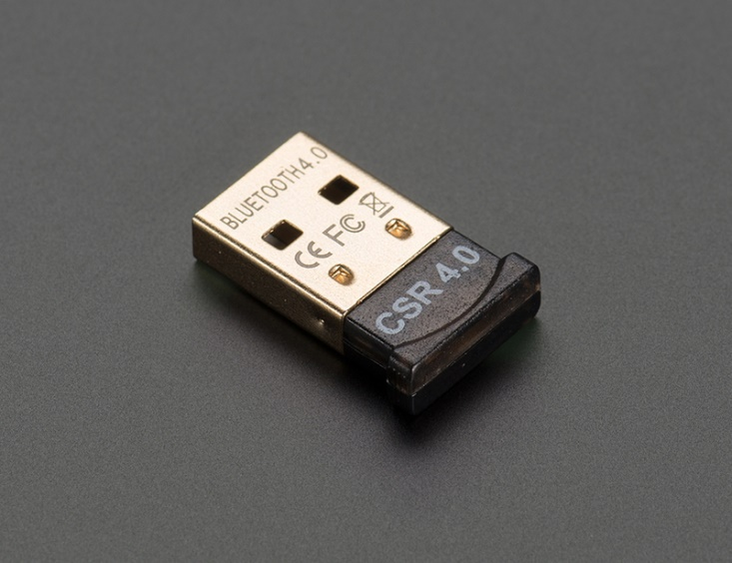
Bluetooth Dongle
A small coin sized bluetooth dongle attached to Raspberry Pi module via USB port.
Connects to any smartphone via bluetooth very easily.
Allows pushing images from Raspberry Pi module to Smartphone.

Slide 10
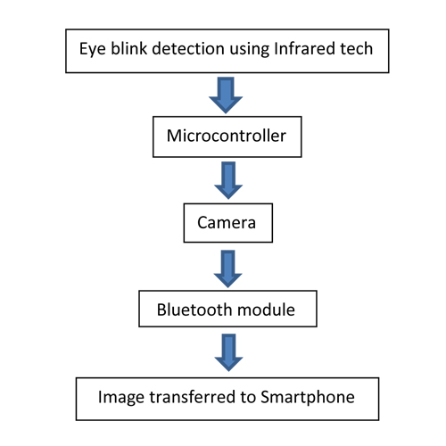
Proposed Solution

Slide 11
Thank You!

